Slide 1


CSE 470 – Incremental and Iterative Model
BRAC University

Slide 2






Sequential Process Model
Customer Don’t Know what they want !!!
Customer know What they Want
Team Lead

Slide 3
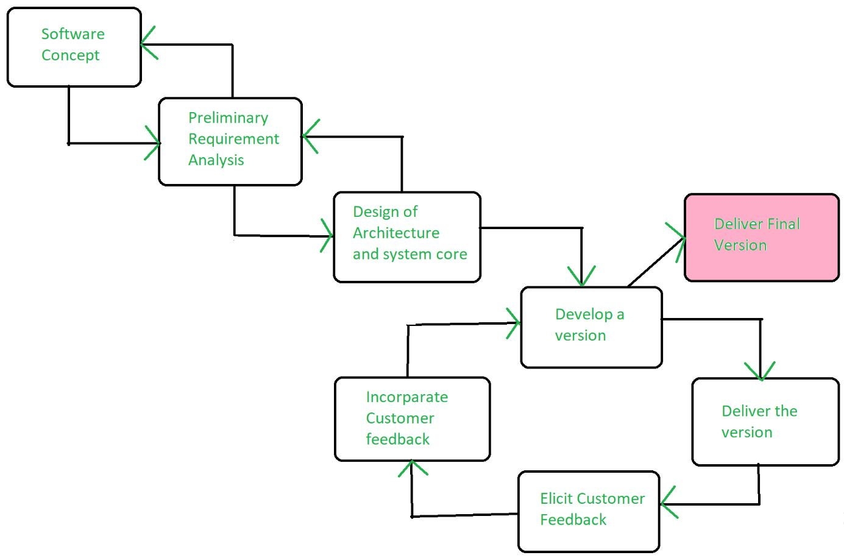
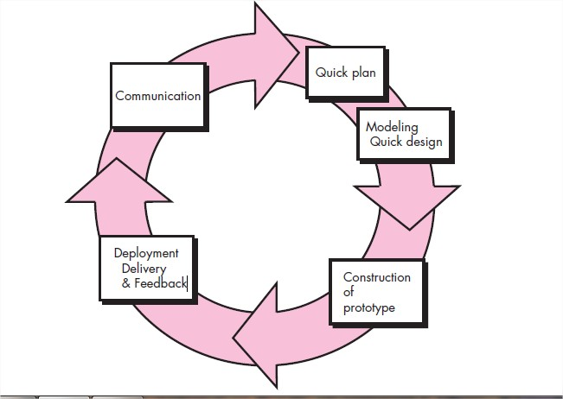
Evolutionary Process Models
Example: Iterative, Incremental and Spiral model
Can change requirements as you want (SRS is not fully done)
Can go back to previous phases, such as after coding, we can go back to communication phase for requirement collection again.
Advantage: Customer involvement, taking feedback from the customer during development make it correct, efficient and reliable, building the right product
Problem: There is a risk of the project expanding beyond its initial scope.

Slide 4

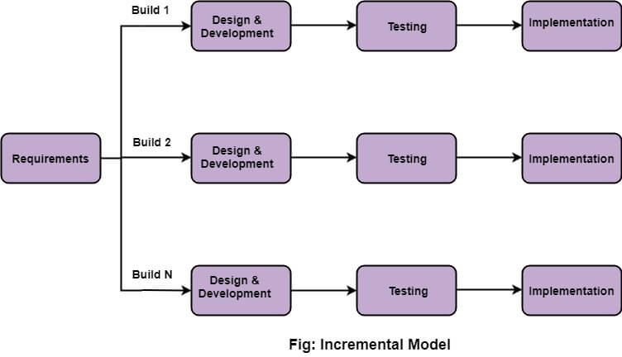
Incremental Process Model
A software process model where the software will be delivered in increments
Customer wants to use the software from the very beginning of the project.
Customer is quite well-known about the requirements (SRS is done and locked at the start of the each phase until development ends of that phase)
The software is divided into fixed number of increments to be delivered to customers

Slide 5
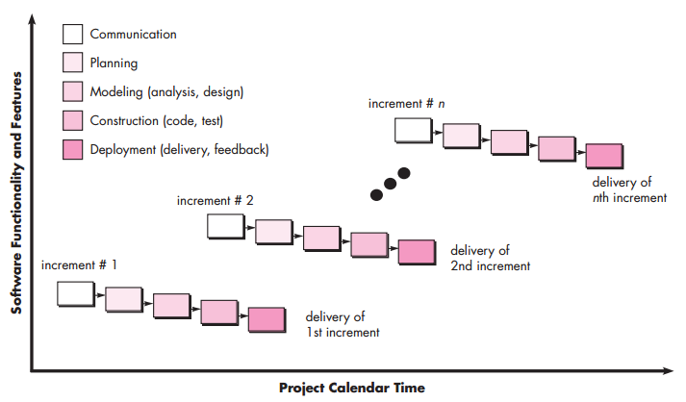
Incremental Process Model

Slide 6
For example, in first increment Login module is delivered. In second increment, another new module such as Navigation module is also added. In third, one more added.
That is, this model “adds onto” new section as increments.
Increment 1
Increment 2
Increment 3
Increment 4
Increment 5

Slide 7

When to use
You are ready with thin slices of the overall software pieces.
Customer wants prototype version of the software from the beginning of the project
Parallel stages such as requirement collection, planning etc. can take place while construction and development phase.
Increments needs to be prioritized by customers, so better chance of success (Customer feedback leads to a successful project)
Better for small or medium size projects

Slide 8
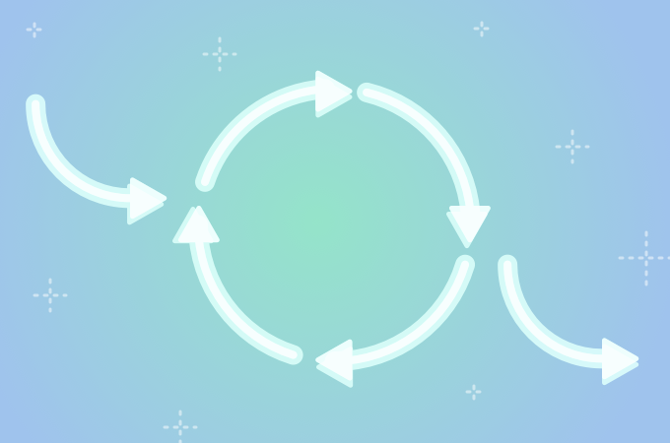
Iterative Process Model
A software process model where the software will be delivered in iterations
Customer is not sure about the requirements
Even development team may not be sure about which technology, algorithms may be used.
There is no fixed limit of iterations, that is time is set aside.

Slide 9
For example, in first iteration Login module is delivered. In second iteration, Login module is updated again. In third iteration, Navigation module is added . And in fourth iteration some refinement is done.
That is, this model “changes or reworks” on same section in iterations until customer accepts it.
Iteration 1
Iteration 2
Iteration 3
Iteration 4
Iteration 5

Slide 10
When to use
Requirements are not fixed
Technological tools or requirements are not identified yet.
Instead of fixed time, quality of the features is refined with time
Customer feedbacks with repetitive iterations increase the product quality
Better for long-term and complex projects

Slide 11

Example Case
Being a project manager of a software company, you have got a project request for developing a corona virus awareness app. The customers initially want the app to show testing info, take appointments, visualize affected area data and many more. Currently, the software should support only Bangla language, however English language support can be added later if the app gets promising feedbacks.
In such a case, which would you apply – Waterfall, Incremental or Iterative?

